Slide 1
Introduction to eSight 21.0 Virtual Resource Management

Slide 2
Upon completion of this course, you will be able to:
Understand the FusionSphere architecture.
Master the routine O&M of eSight virtual resources.
Be familiar with the features of eSight virtual resources.

Slide 3
1
FusionSphere Overview
2
O&M Analysis
3
Routine O&M

Slide 4
Introduction to IT Infrastructure Capability Evolution
Single-node system
Resource integration
Cloud
Discrete system
Intensive system
Highly resilient system
Traditional IT infrastructure
Virtualization
Resource pooling
Basic services
Infrastructure
capabilities
VM
VM
Virtual
desktop
Centralized resource management
Computing
Storage
Network
Container
Physical machine silos
Virtualization silos
Automatic resource orchestration
Virtualization
Server
Standard
hardware
Standard
hardware
Standard
hardware
Physical machine deployment and low device usage
Technologies:
Virtualized deployment
Benefits:
Higher device usage
Simplified O&M
Technologies:
The management platform integrates virtualization silos as resource pools.
Benefits:
Centralized management
Sharing
Technologies:
Automation
Self-service
Benefits:
Multi-team, large-scale concurrent collaboration
Institutionalized/Standardized/Measurable IT activities
O&M support IT > Operations IT
FusionSphere
solution
The FusionSphere solution deploys virtualization software on physical servers to use one physical server as multiple ones. The FusionSphere organizes workloads and uses the remaining servers to deploy new applications and solutions, achieving a high integration rate.

Slide 5

FusionSphere Architecture
Web & Mobile
SAP HANA
HPC
Big Data
NFVI
IT Hosting
AI
...
Compute services
Storage service
Network services
Elastic Cloud Server
(ECS)
Image Mgmt Service
(IMS)
Auto Scaling
(AS)
Bare Metal Server
(BMS)
Elastic Volume Service
(EVS)
Volume Backup Service
(VBS)
Virtual Private Cloud
(VPC)
Elastic Load Balance
(ELB)
Centralized O&M
FusionSphere
Service migration
FusionCompute
FusionStorage
FusionNetwork
Infrastructure
Server
Storage
Network

Slide 6
FusionSphere Management on eSight
Third-party systems
Alarm
HTTP
Resource
HTTP
Performance
FTP
eSight
Northbound
Resource management
Performance management
Alarm management
FusionSphere
REST
REST
SNMP
Huawei OpenStack (commercial release)
O&M
Keystone
Heat
Web portal
Glance
Nova
Cinder
Neutron
Ceilometer
Swift
Nova-Compute
Driver
Cinder-Volume
Driver
Neutron
Plug-in
Ironic
Service provisioning
(SSP)
Security management
(IAM)
FusionCompute: virtual computing
FusionStorage: virtual storage
FusionNetwork: virtual network
Cluster scheduling
Advanced extended features:
HA/hot migration...
Storage offloading
Advanced storage features:
Thin provisioning/snapshot/DR...
SDN controller
Virtual service gateways: vFW/vLB...
Application monitoring and alarm (AM & FM)
Integrated resource management (IRM)
Universal Virtualization Platform (UVP)
Distributed storage engine (DSware)
Elastic virtual switch (EVS/VxLAN)
Automatic application management
(AME)
Common services - loading, deployment, and software management
Cloud Boot Service (CBS)
Cloud Provisioning Service (CPS)
Software management (upgrade and patch)
Heterogeneous hardware adaptation
Infrastructure
Computing
Storage
Network

Slide 7
1
FusionSphere Overview
2
O&M Analysis
3
Routine O&M

Slide 8




Overall O&M Requirements
Centralized resource management
Centralized alarm monitoring
Association between virtual and physical resources
I am an O&M supervisor. I want to know the distribution and overall health status of all resources. I am a monitoring engineer. I want to know all abnormal resources.
During routine monitoring, I want to know all alarms in a timely manner. After receiving an alarm, I can know the location and impact of the fault, which helps me to identify, analyze, and rectify the fault.
During fault locating and analysis, I want to understand the association between the virtualization system to which the virtual resources belong and the physical resources where the virtual resources are located.

Slide 9
O&M Requirements for Different Roles
Overall structure
Health status
Capacity status
Energy efficiency status
Analysis report
Enterprise DC
O&M supervisor
Physical resource monitoring
Virtual resource monitoring
Application resource monitoring
Multi-dimensional O&M data analysis
Analysis report
Branch DC in a region
O&M supervisor
Quick search
360-degree analysis
Auxiliary analysis tools
Auxiliary troubleshooting tools
Branch DC in a region
O&M personnel
Alarms
Top N monitoring
Major concerns
Remote notification
Record and playback
Branch DC in a region
O&M monitoring personnel

Slide 10
Key Features of Virtual Resource Monitoring
Key Feature | Description
Virtual resource 360° details management | Displays basic information about FusionSphere overview, hosts, VMs, and storage resources. Displays network resource information, such as virtual networks, ports, routers, and floating IP addresses, helping users view the allocation and usage of virtual networks.
Virtual resource alarm | Displays alarm information about FusionSphere, hosts, and VMs.
Historical KPI analysis of virtual resources | Displays historical KPIs of hosts, VMs, host ports, host file systems, and backend storage.
Northbound resource interface | Provides northbound interfaces for virtual resources to interconnect with the upper-layer system. Supports real-time monitoring of resource changes and sends real-time notifications about the changes to the upper-layer system over the northbound interface.
Northbound performance interface | Sends historical performance data in files to the upper-layer system in FTP mode.
Global search | Quickly searches for resources such as hosts, VMs, and virtual ports, and supports one-click redirection to the corresponding resource details page.
Virtualization topology | Displays hosts and VMs in the topology, fully displays resources and their status, performance, alarm, link, and other information on one screen, and associates with the IT infrastructure and network access layers.

Slide 11
Application Scenario - Quick Server Fault Detection
5
Application scenario:
If a physical server (such as E9000) breaks down (the blade is removed) or a server CPU, RAID group, NIC, or SAS cable fault occurs, the VNFM promptly detects the affected VMs and the VNF services on the VMs, updates statuses, automatically performs switchovers, and notifies O&M personnel.
VNF
(vEPC/vIMS)
VNFM
4
3
6
VM
eSight
2
7
OpenStack
Cloud platform
The E9000 reports hardware alarms in SNMP trap mode.
eSight processes the alarms and queries the list of VMs affected by the hardware.
Send HTTP message to notify the VNFM.
The VNFM receives the notification and identifies the affected VNFs based on the VM information
The VNFM updates the VNF status (using the pipe OS to notify the VNF master node).
The VNFM connects to the resource pool and updates the VM status (by host).
eSight connects to the resource pool and refreshes the VM status (by host).
E9000
1
Blade
System architecture

Slide 12
Application Scenario: Tenants Report that Leased VMs Cannot Be Connected or Operations Are Slow
Check whether similar problems occur in other regions.
A tenant reports a fault.
Health status of the DC where the tenant is located
Egress bandwidth traffic status of the DC where the tenant is located
Health statuses of other DCs
Provide pre-warning for faults of other tenants and check whether health problems occur in the region where the tenant reports the fault.
Describe the fault symptom.
Provide identification information about virtual resources.
Quickly locate resources and perform 360° analysis.
Top N cluster, server, and VM statistics analysis
360º comprehensive analysis of server objects (one-click redirection to the server MOUI)
Global search
360º analysis of VM Objects
Static configuration information
Historical performance data
Alarm information
Analysis of the impact on sibling nodes

Slide 13
1
FusionSphere Overview
2
O&M Analysis
3
Routine O&M

Slide 14
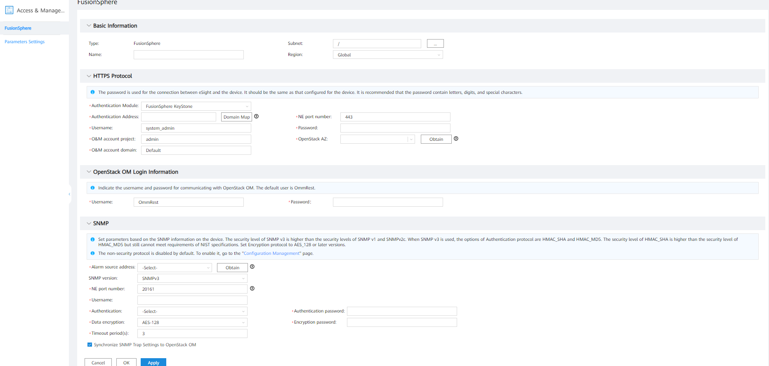
Adding a Single FusionSphere
Adding a single FusionSphere

Slide 15
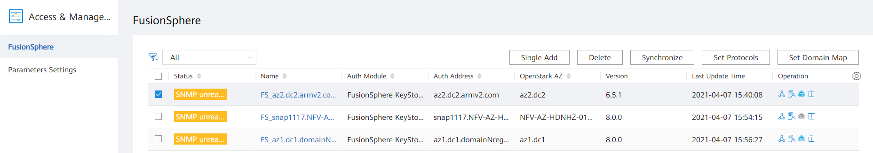
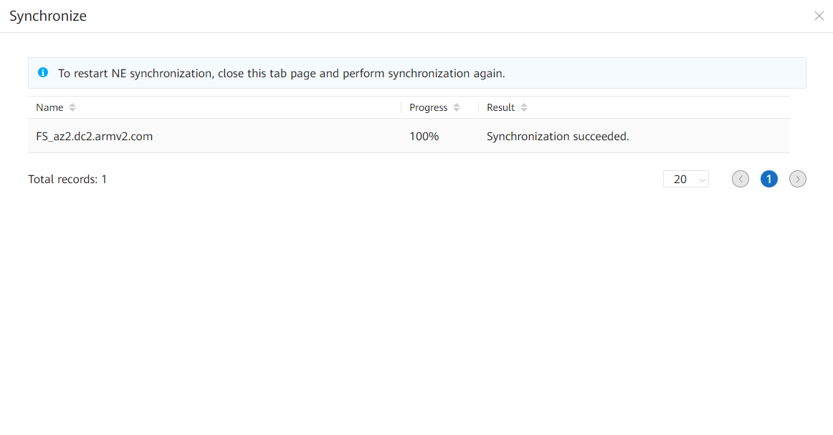
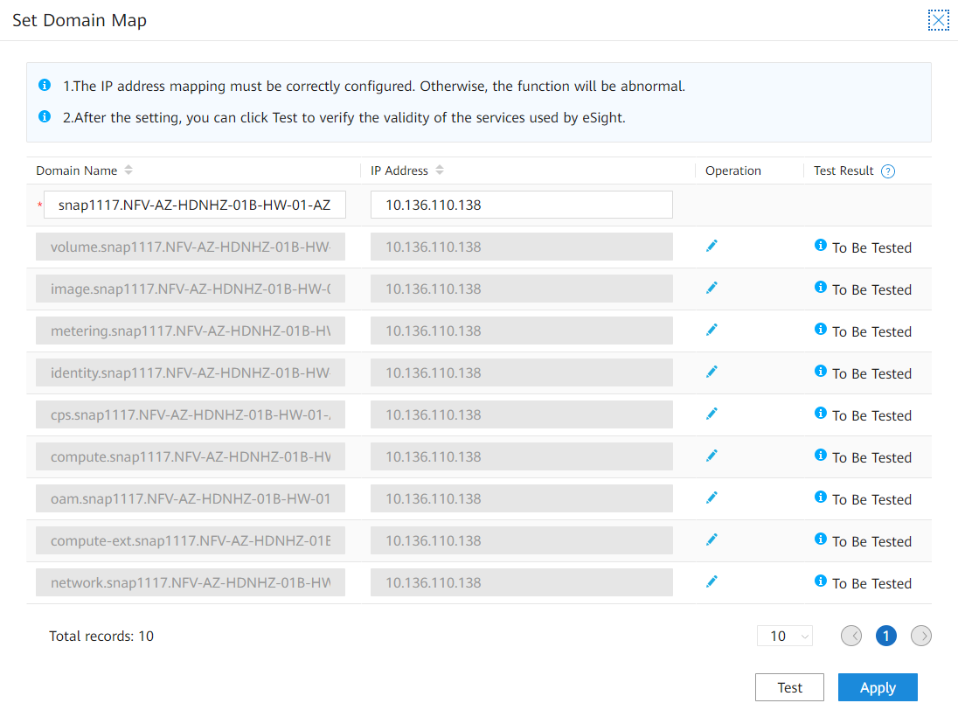
FusionSphere List
The FusionSphere list supports single/batch deletion, manual resource synchronization, protocol settings, and domain name mapping.
Click here to go to the resource overview page.
Manual and real-time resource synchronization
Supports domain name mapping configuration, eliminating the need to manually configure the hosts file and improving resource addition efficiency

Slide 16
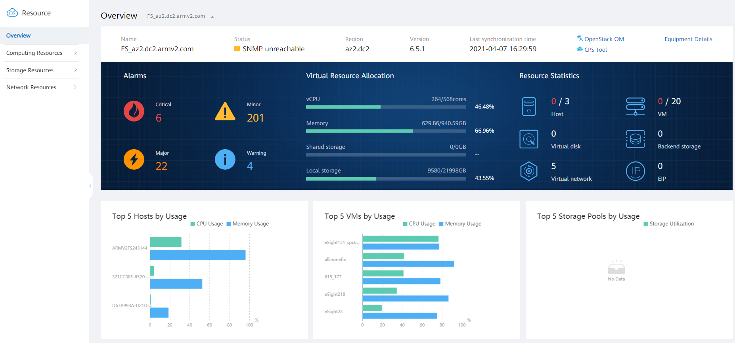
FusionSphere Resource Overview
FusionSphere resource overview: Alarm, performance, and resource statistics are displayed on one screen.
Allows users to query alarms, resource allocation, resource statistics, and top N hosts, VMs, and storage pools by FusionSphere, AZ, or HA.

Slide 17
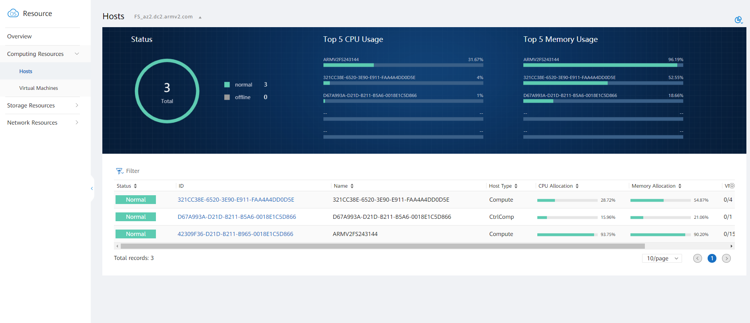
FusionSphere Host Resource Statistics
FusionSphere host resource statistics: real-time analysis of statuses and top N resource usage
Allows users to query the host resource status, CPU usage, memory usage, and host list by FusionSphere, AZ, or HA.
Click here to query 360° host details.

Slide 18
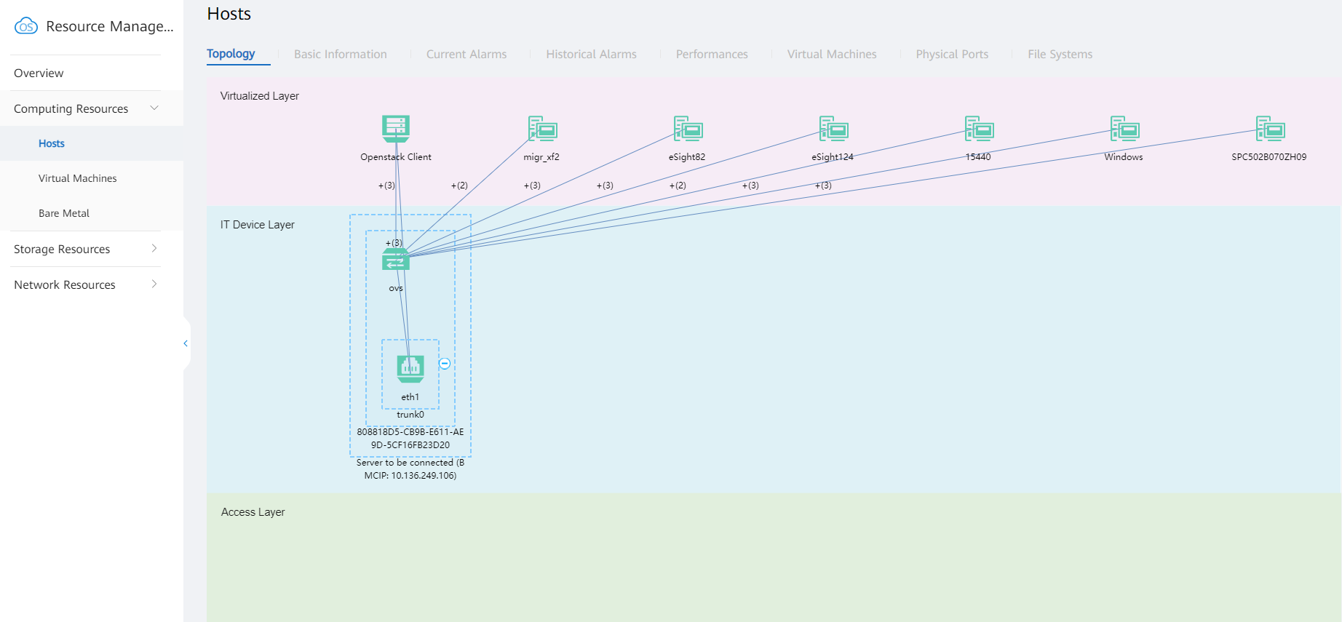
FusionSphere 360° Host Details
Allows users to query FusionSphere host details, including topology, basic information, current alarms, historical alarms, historical performance data, and sub-resource lists of VMs, physical ports, and file systems.
FusionSphere 360° host details

Slide 19
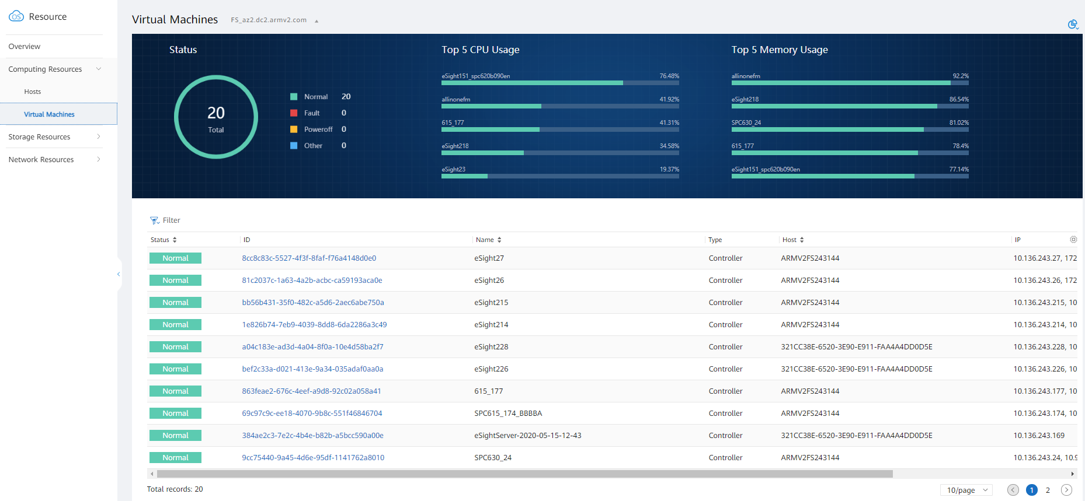
FusionSphere VM Resource Statistics
FusionSphere VM resource statistics: real-time analysis of statuses and top N resource usage
Allows users to query the VM resource status, CPU usage, memory usage, and VM list by FusionSphere, AZ, or HA.
Click here to query 360° VM details.

Slide 20
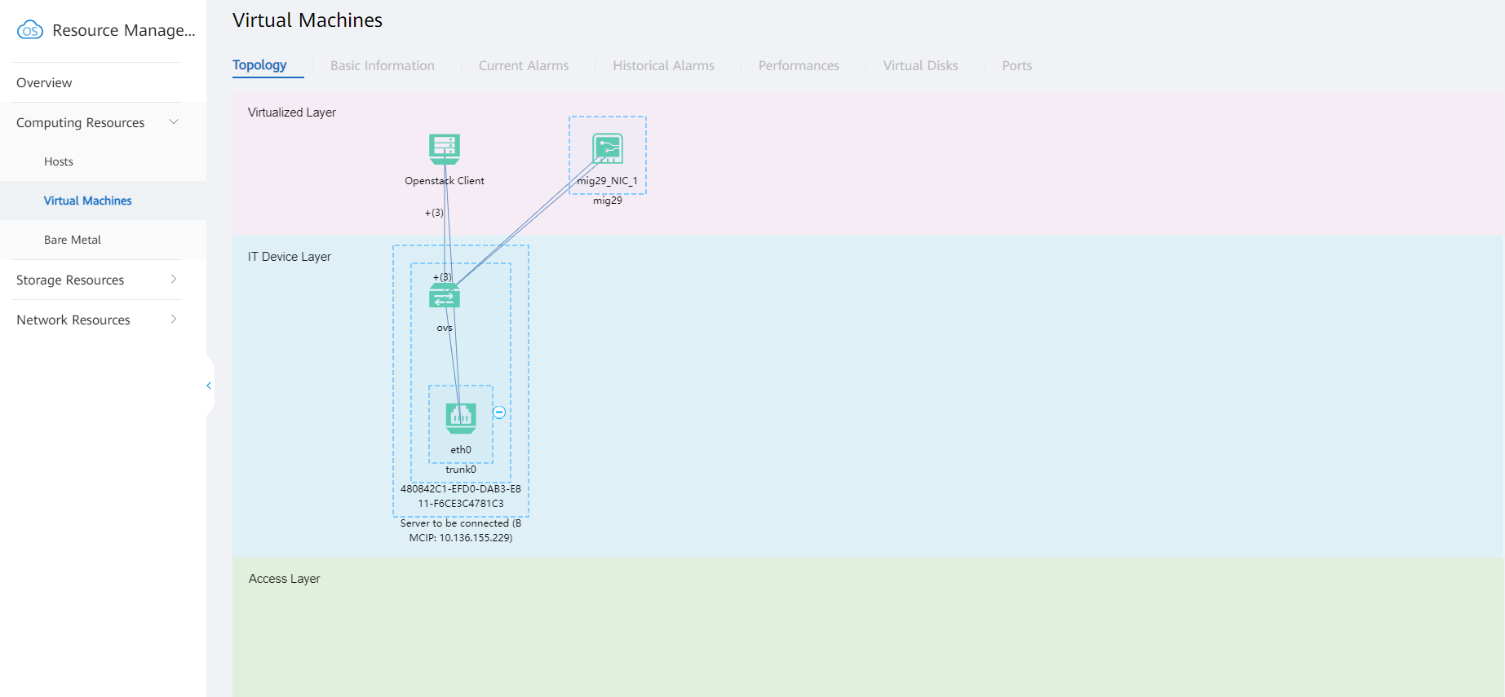
FusionSphere 360° VM Details
FusionSphere 360° VM details
Allows users to query FusionSphere VM details, including topolopy, basic information, current alarms, historical alarms, historical performance data, and sub-resource lists of virtual disks and ports.

Slide 21
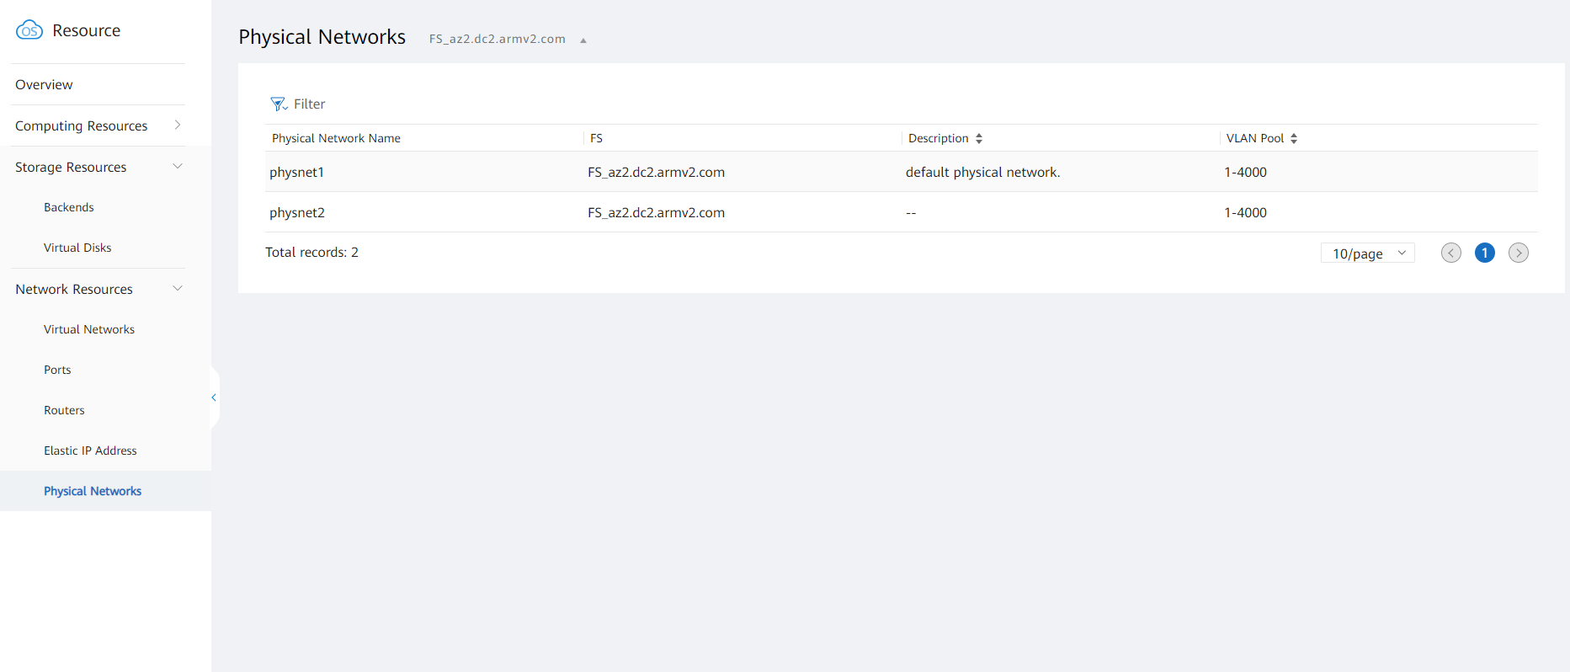
FusionSphere Computing and Storage Resources
FusionSphere computing and storage resources
Allows users to query the list and details of storage resources, such as backend storage and virtual disks.
Allows users to query the list and details of network resources, such as virtual networks, ports, routers, elastic IP addresses, and physical networks.
Allows users to query the associated port list based on the network name, switches to the network management page based on the network name or the network name associated with the router.

Slide 22
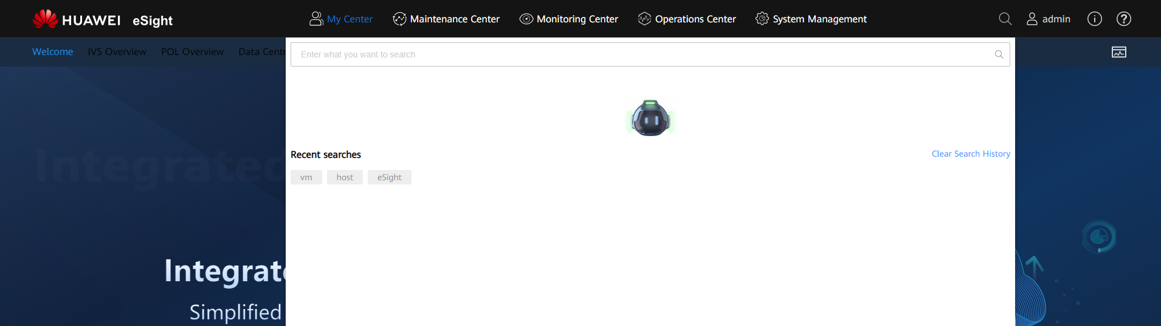
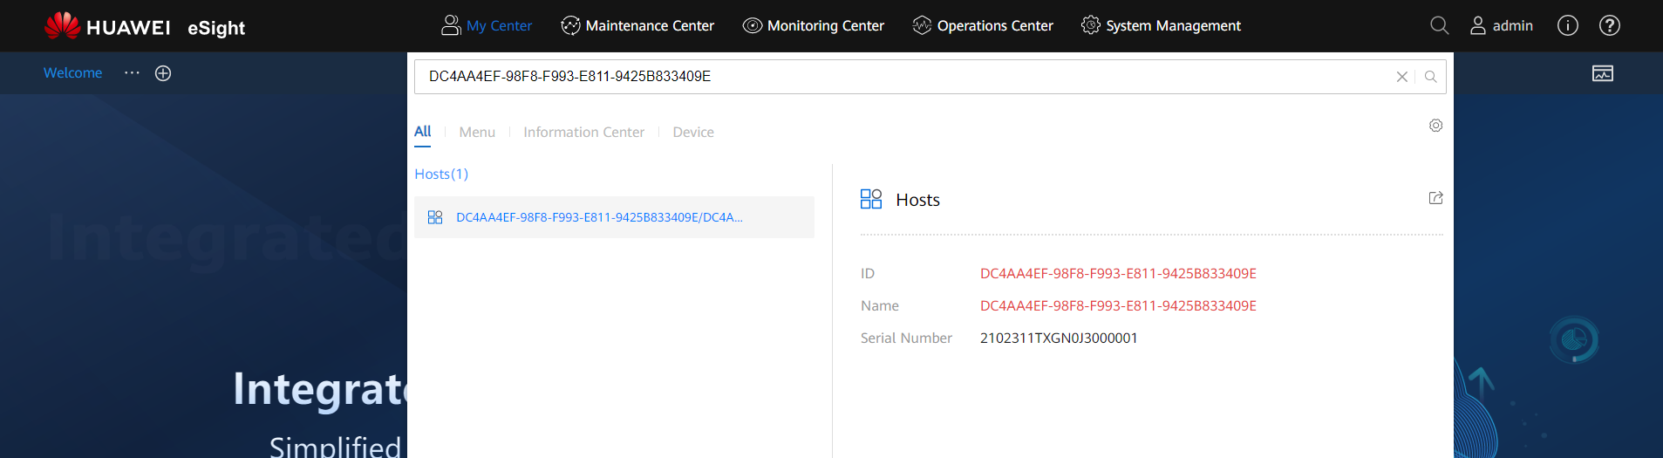
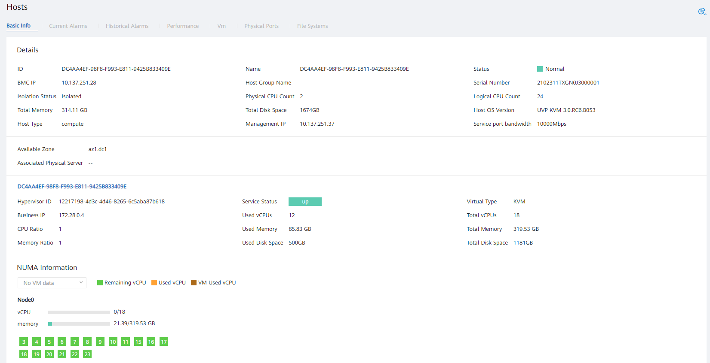
Global Search: Quickly Locating Resources to Improve O&M Efficiency
Provides a convenient search entry and supports quick search for resources, such as hosts, VMs, and virtual ports.
Global search entry, which is used to search for resources based on key attributes
Quickly locate the abnormal resources based on its key attributes and switch to the resource MOUI for 360° analysis.

Slide 23
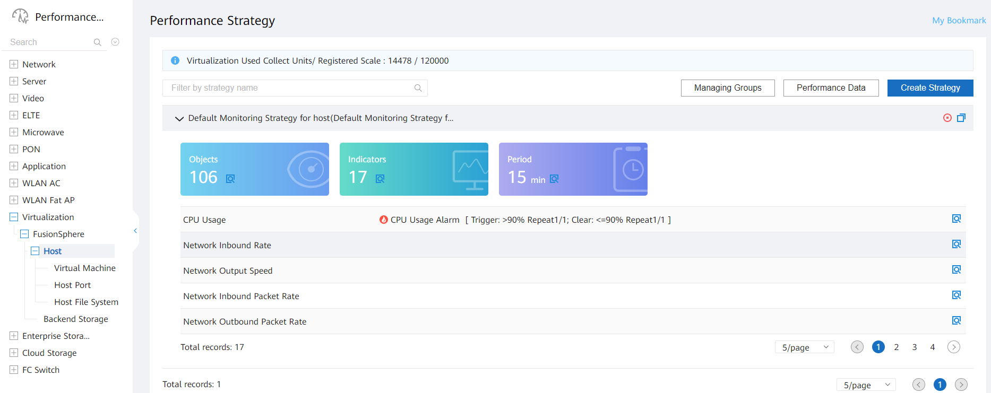
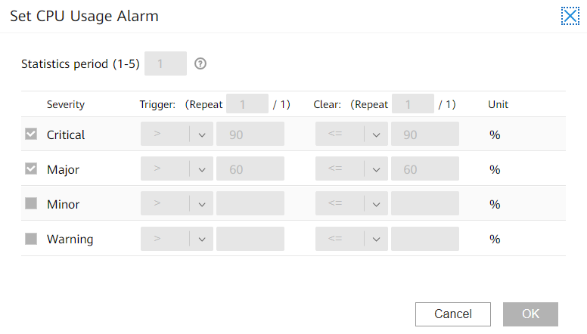
Performance Management - Preset, OTTB Performance Policies
Performance policies can be created, copied, and stopped, and added to the favorites folder.
Preset monitoring policies for common KPIs are provided to automatically collect performance data after resources are connected.
Set alarm thresholds for KPIs. When a KPI value reaches the threshold, an alarm of the corresponding severity is generated.

Slide 24
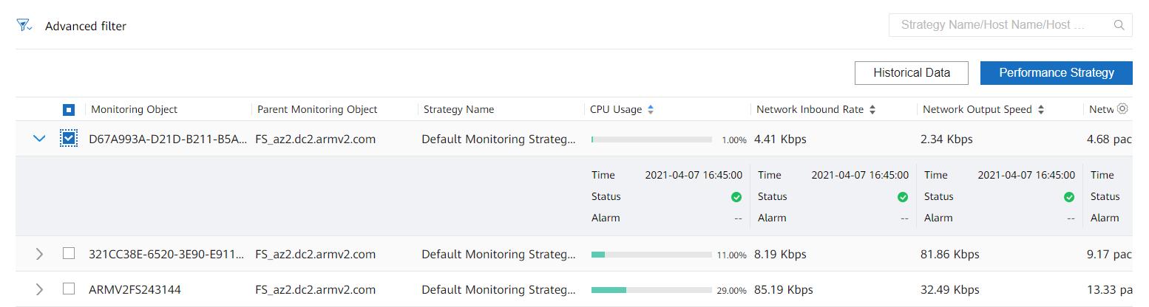
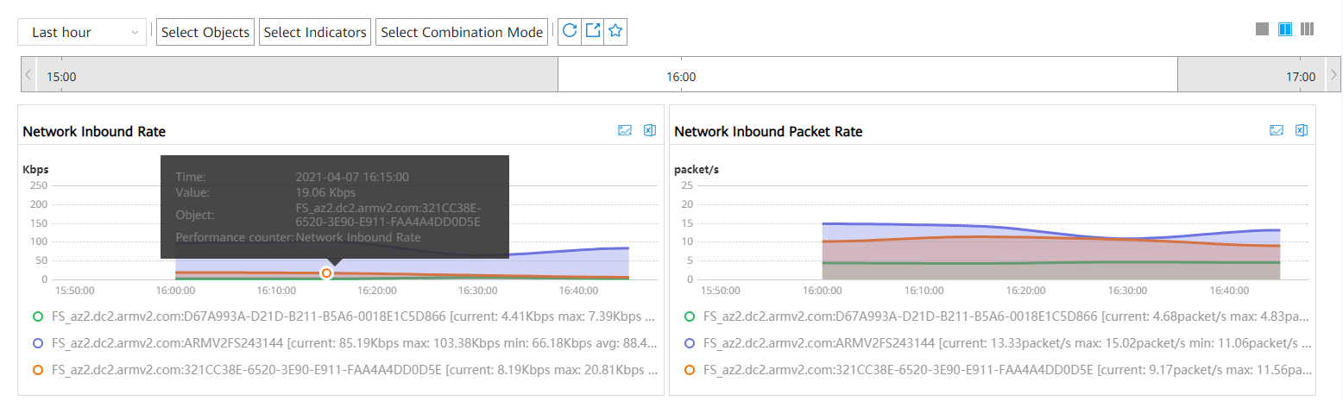
Performance Management - Performance Data
Current data: The current collection statuses and alarm statuses are clearly displayed
Historical data: Query data from different dimensions to quickly compare and identify exceptions.

Slide 25
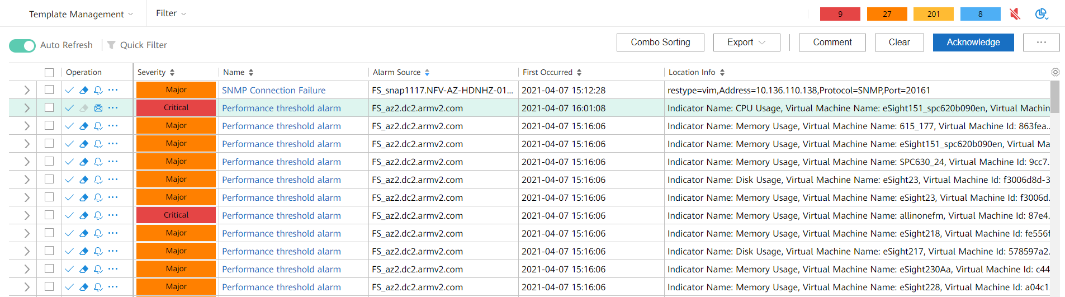
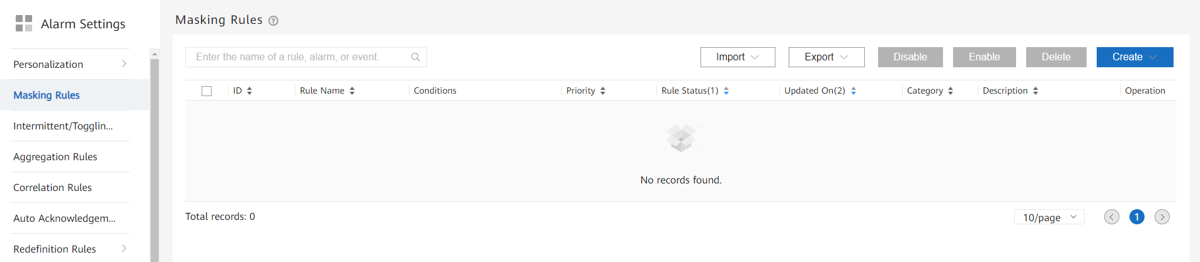
Alarm Management
Alarm list: Alarms of different devices can be selected and filtered. Alarms can be synchronized, cleared, and acknowledged.
Alarm settings: Users can configure customized settings, alarm masking, aggregation rules, and automatic acknowledgment. Multiple alarm management solutions are provided.

